Slide 1
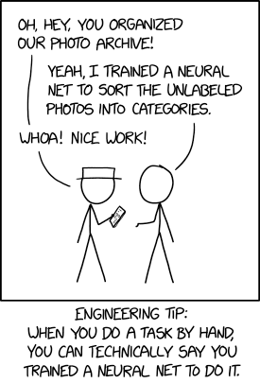
Trustworthy AI
Robert Pless
George Washington University
xkcd.com

Slide 2
Trustworthy AI
“Only at GWU”
Monday January 13: Introduction to Trust & AI by Robert Pless
Monday January 27: Model Risk Management by Patrick Hall
Monday February 3: Class replaced by: TRAILS Conference
Monday February 10: Natural Language Processing & Language Models by Rebecca Hwa
Monday February 24: Mechanisms of Human Oversight in Training AI Systems by Shi Feng
Monday March 3: Humanistic Views on Trust, Creativity, and AI by Alexa Joubin
Monday March 17: Trust Models and Misinformation in Social Media by David Broniatowski
Monday March 24: Global AI Governance by Susan Aaronson
Monday March 31: Safety and Systems Assurance in Deployed Systems by Peng Wei
6 more lectures.

Slide 3
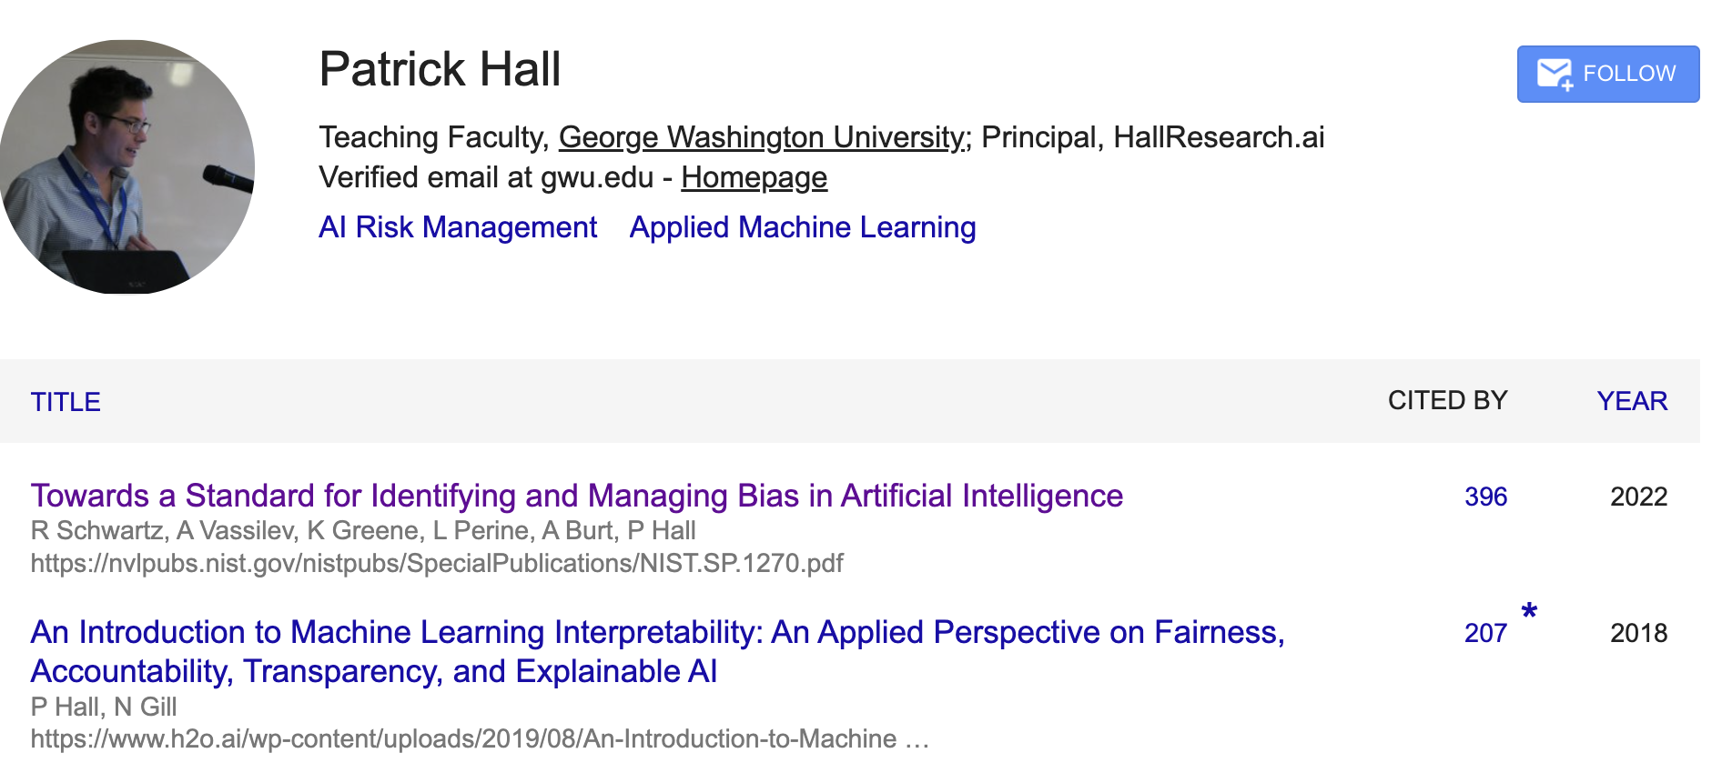
Trustworthy AI
“Only at GWU”
Monday January 13: Introduction to Trust & AI by Robert Pless
Monday January 27: Model Risk Management by Patrick Hall
Monday February 3: Class replaced by: TRAILS Conference
Monday February 10: Natural Language Processing & Language Models by Rebecca Hwa
Monday February 24: Mechanisms of Human Oversight in Training AI Systems by Shi Feng
Monday March 3: Humanistic Views on Trust, Creativity, and AI by Alexa Joubin
Monday March 17: Trust Models and Misinformation in Social Media by David Broniatowski
Monday March 24: Global AI Governance by Susan Aaronson
Monday March 31: Safety and Systems Assurance in Deployed Systems by Peng Wei
6 more lectures.

Slide 4
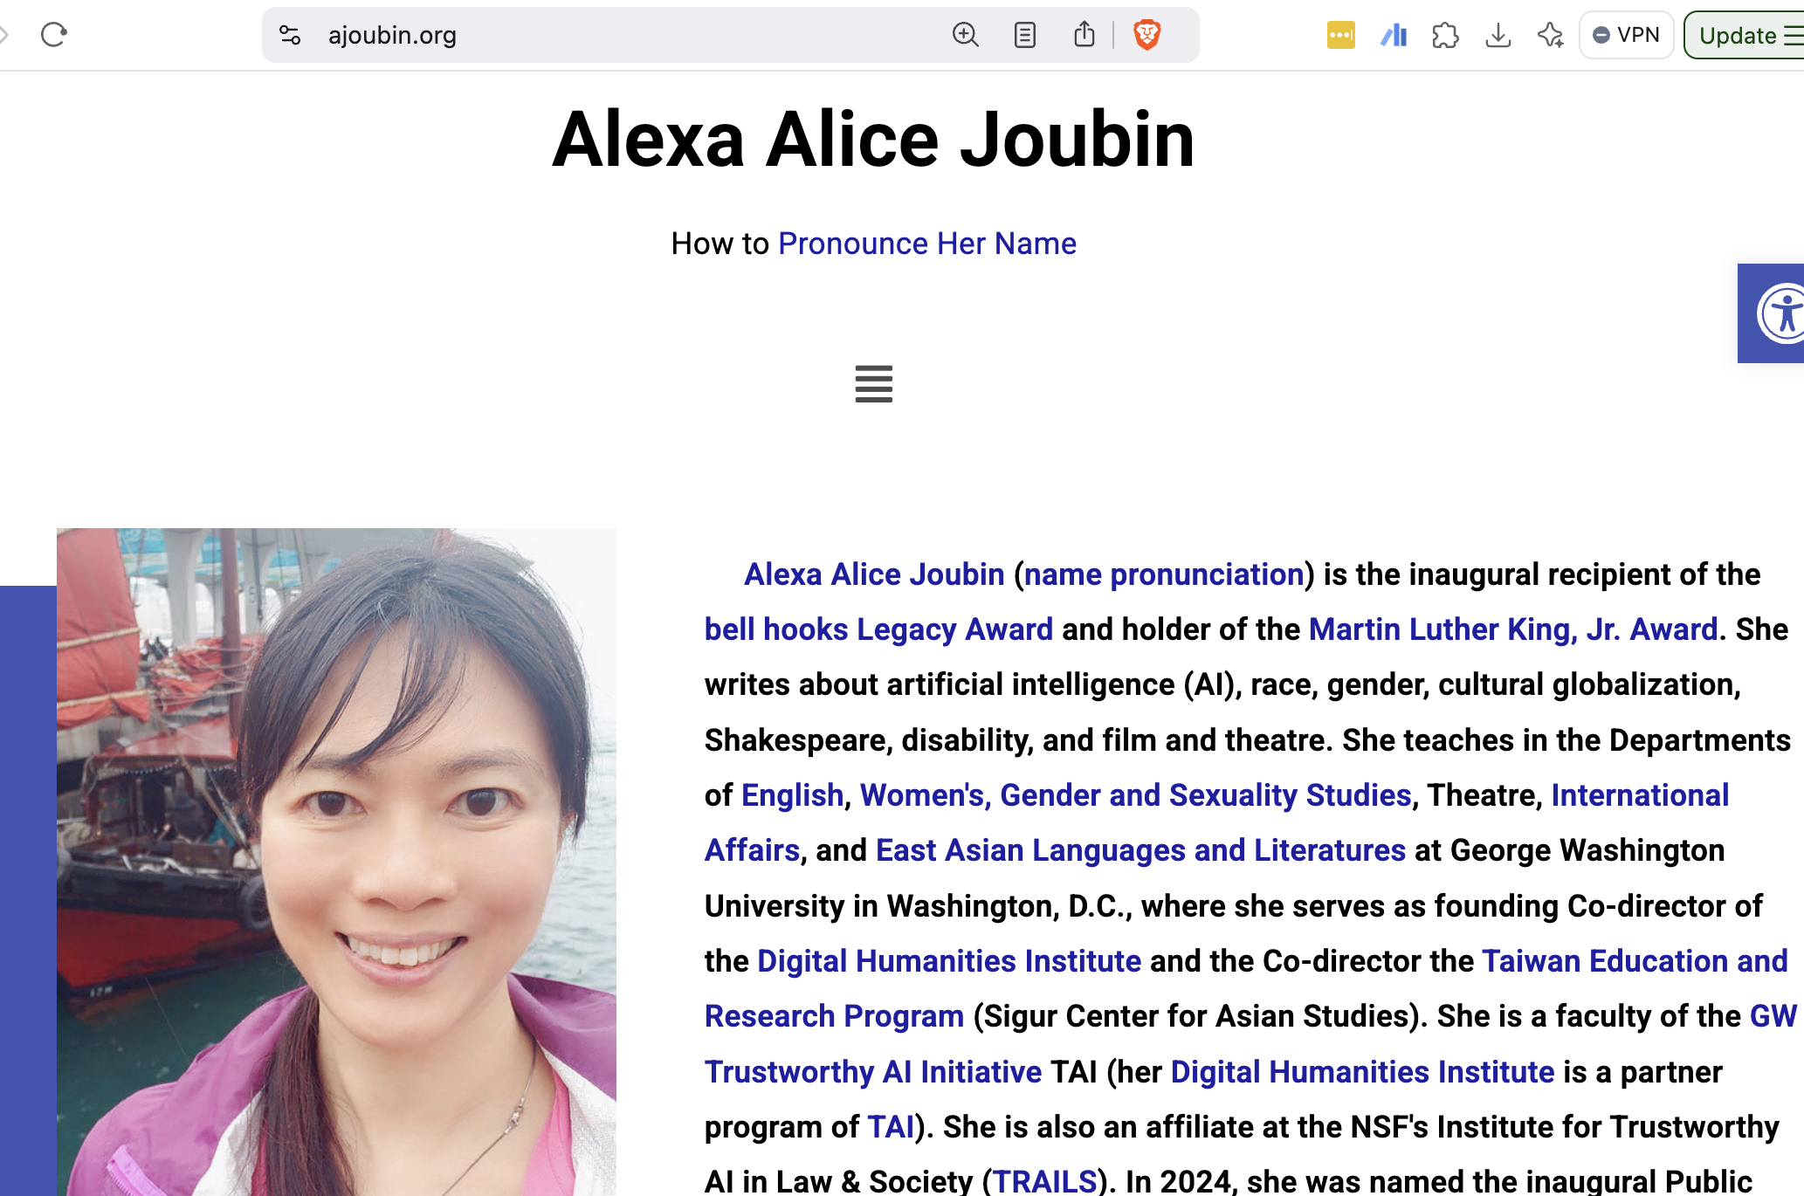
Trustworthy AI
“Only at GWU”
Monday January 13: Introduction to Trust & AI by Robert Pless
Monday January 27: Model Risk Management by Patrick Hall
Monday February 3: Class replaced by: TRAILS Conference
Monday February 10: Natural Language Processing & Language Models by Rebecca Hwa
Monday February 24: Mechanisms of Human Oversight in Training AI Systems by Shi Feng
Monday March 3: Humanistic Views on Trust, Creativity, and AI by Alexa Joubin
Monday March 17: Trust Models and Misinformation in Social Media by David Broniatowski
Monday March 24: Global AI Governance by Susan Aaronson
Monday March 31: Safety and Systems Assurance in Deployed Systems by Peng Wei
6 more lectures.

Slide 5

Trustworthy AI
“Only at GWU”
Monday January 13: Introduction to Trust & AI by Robert Pless
Monday January 27: Model Risk Management by Patrick Hall
Monday February 3: Class replaced by: TRAILS Conference
Monday February 10: Natural Language Processing & Language Models by Rebecca Hwa
Monday February 24: Mechanisms of Human Oversight in Training AI Systems by Shi Feng
Monday March 3: Humanistic Views on Trust, Creativity, and AI by Alexa Joubin
Monday March 17: Trust Models and Misinformation in Social Media by David Broniatowski
Monday March 24: Global AI Governance by Susan Aaronson
Monday March 31: Safety and Systems Assurance in Deployed Systems by Peng Wei
6 more lectures.

Slide 6
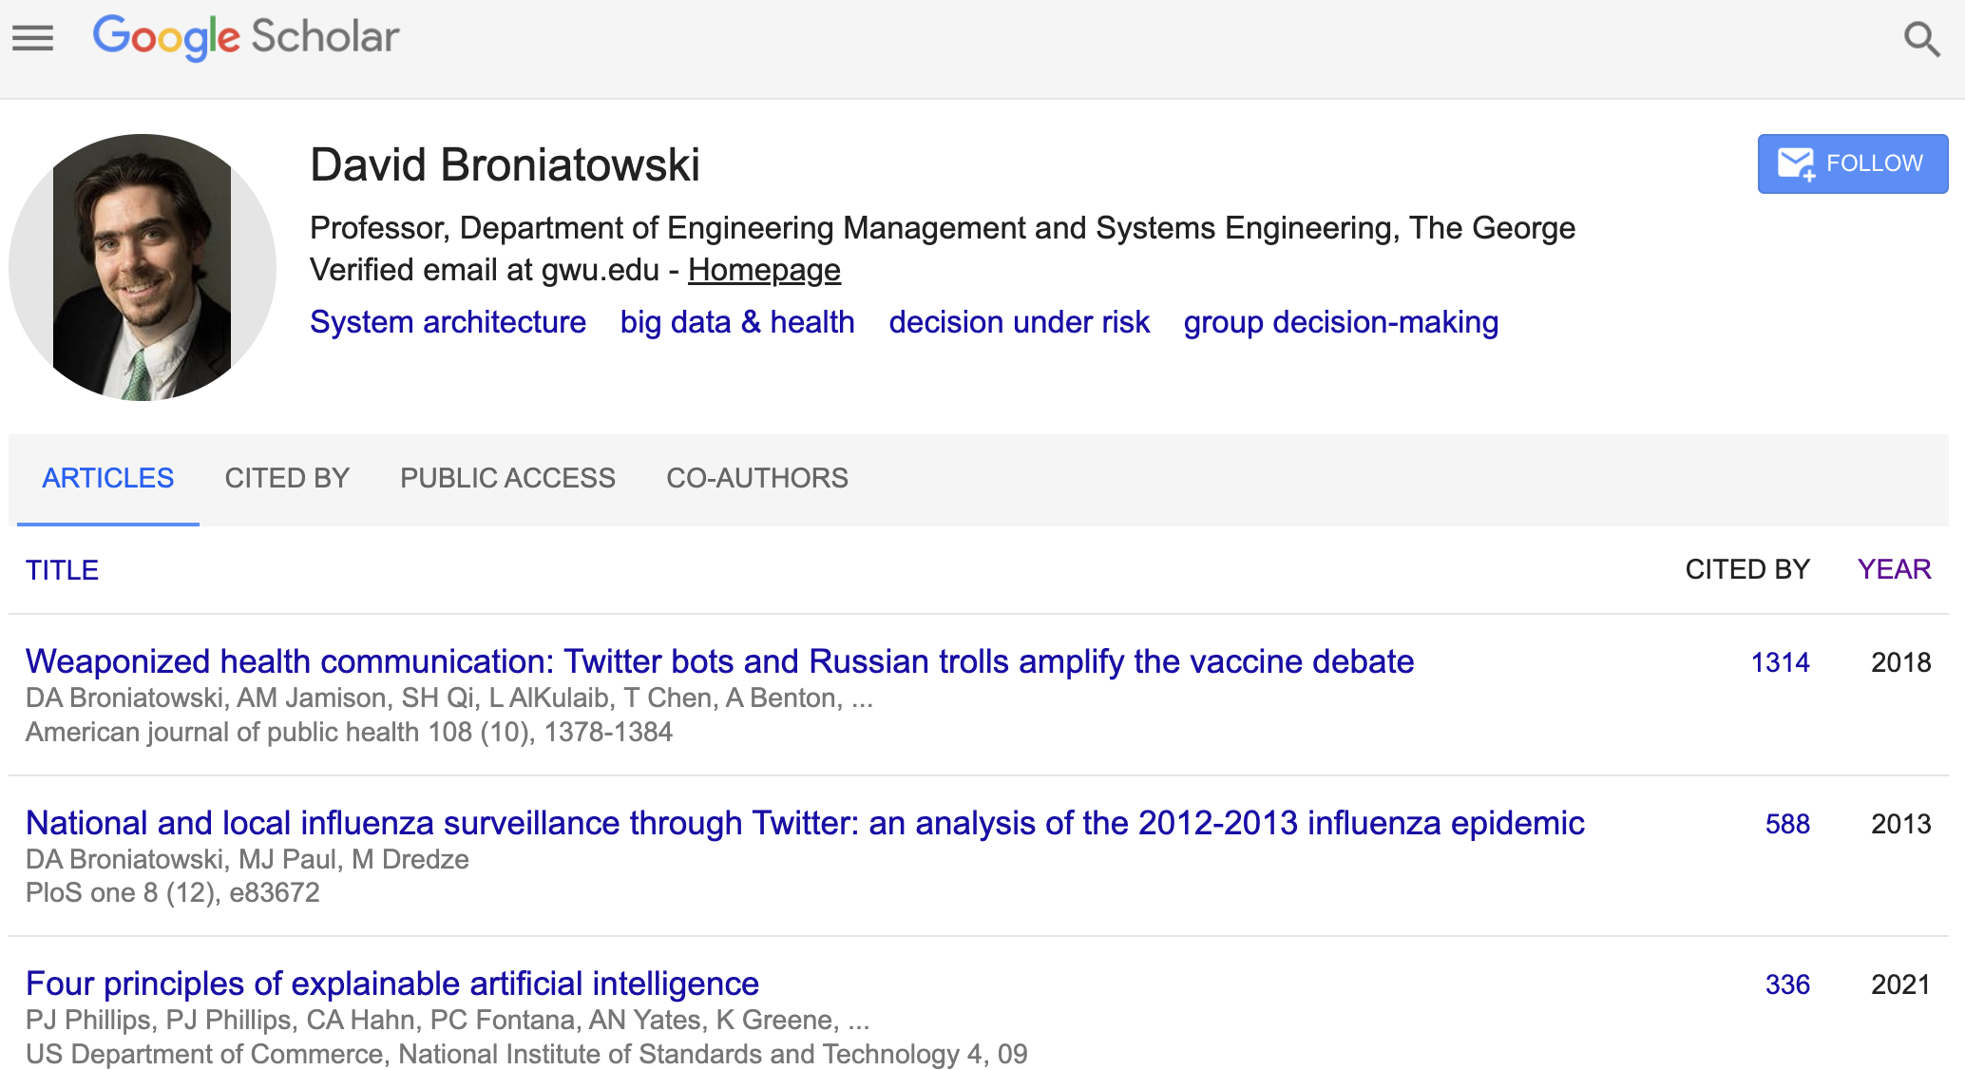
Trustworthy AI
“Only at GWU”
Monday January 13: Introduction to Trust & AI by Robert Pless
Monday January 27: Model Risk Management by Patrick Hall
Monday February 3: Class replaced by: TRAILS Conference
Monday February 10: Natural Language Processing & Language Models by Rebecca Hwa
Monday February 24: Mechanisms of Human Oversight in Training AI Systems by Shi Feng
Monday March 3: Humanistic Views on Trust, Creativity, and AI by Alexa Joubin
Monday March 17: Trust Models and Misinformation in Social Media by David Broniatowski
Monday March 24: Global AI Governance by Susan Aaronson
Monday March 31: Safety and Systems Assurance in Deployed Systems by Peng Wei
6 more lectures.

Slide 7
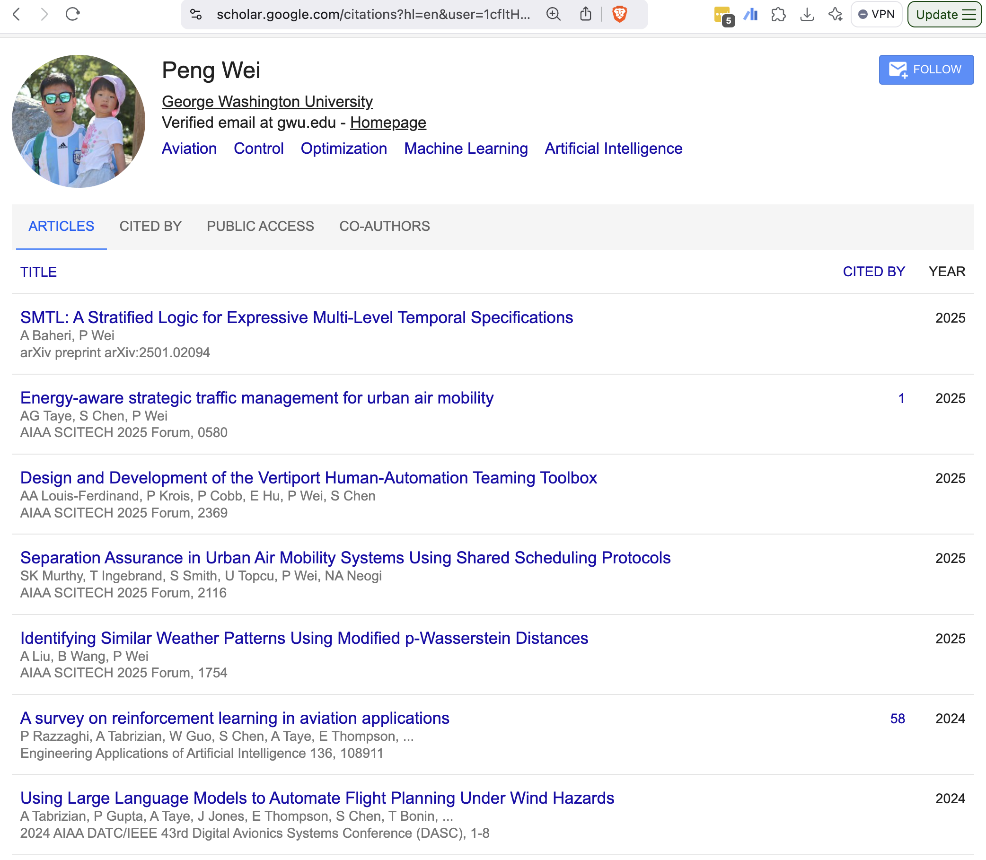
Trustworthy AI
“Only at GWU”
Monday January 13: Introduction to Trust & AI by Robert Pless
Monday January 27: Model Risk Management by Patrick Hall
Monday February 3: Class replaced by: TRAILS Conference
Monday February 10: Natural Language Processing & Language Models by Rebecca Hwa
Monday February 24: Mechanisms of Human Oversight in Training AI Systems by Shi Feng
Monday March 3: Humanistic Views on Trust, Creativity, and AI by Alexa Joubin
Monday March 17: Trust Models and Misinformation in Social Media by David Broniatowski
Monday March 24: Global AI Governance by Susan Aaronson
Monday March 31: Safety and Systems Assurance in Deployed Systems by Peng Wei
6 more lectures.

Slide 8
Trustworthy AI
“Only at GWU”
Monday January 13: Introduction to Trust & AI by Robert Pless
Monday January 27: Model Risk Management by Patrick Hall
Monday February 3: Class replaced by: TRAILS Conference
Monday February 10: Natural Language Processing & Language Models by Rebecca Hwa
Monday February 24: Mechanisms of Human Oversight in Training AI Systems by Shi Feng
Monday March 3: Humanistic Views on Trust, Creativity, and AI by Alexa Joubin
Monday March 17: Trust Models and Misinformation in Social Media by David Broniatowski
Monday March 24: Global AI Governance by Susan Aaronson
Monday March 31: Safety and Systems Assurance in Deployed Systems by Peng Wei
6 more lectures.

Slide 9
Trustworthy AI
“Only at GWU”
Monday January 13: Introduction to Trust & AI by Robert Pless
Monday January 27: Model Risk Management by Patrick Hall
Monday February 3: Class replaced by: TRAILS Conference
Monday February 10: Natural Language Processing & Language Models by Rebecca Hwa
Monday February 24: Mechanisms of Human Oversight in Training AI Systems by Shi Feng
Monday March 3: Humanistic Views on Trust, Creativity, and AI by Alexa Joubin
Monday March 17: Trust Models and Misinformation in Social Media by David Broniatowski
Monday March 24: Global AI Governance by Susan Aaronson
Monday March 31: Safety and Systems Assurance in Deployed Systems by Peng Wei
6 more lectures.

Slide 10
Structure of the class
Most days will be guest lecture (first hour) + activity (second half)
Guest lecture is likely to include assigned reading.
Grades will be based on:
Question/comments submitted about assigned reading before lecture via Google form.
3-4 small projects turned in as a blog post.
Final project to be presented as a poster session
Multiple choice/very short answer exam based on guest lectures.

Slide 11
Today
My perspective on AI/Machine Learning
Overview AI/ML/Deep Learning/Reinforcement Learning
Neural Networks and what makes Deep Learning Deep?
Generative Models

Slide 12
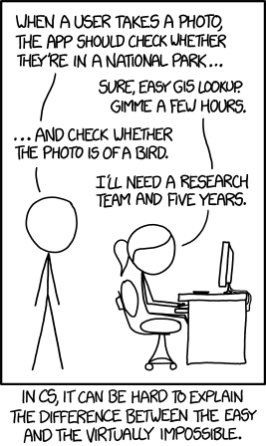
Computer Vision
Originally a mix of Geometry, Statistics and Optics
Currently nearly completely focused on Machine Learning
Notes:
My example of AI and Machine Learning will tilt more towards Computer Vision than some.

Slide 13
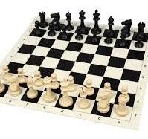
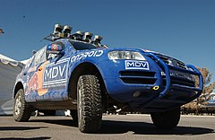
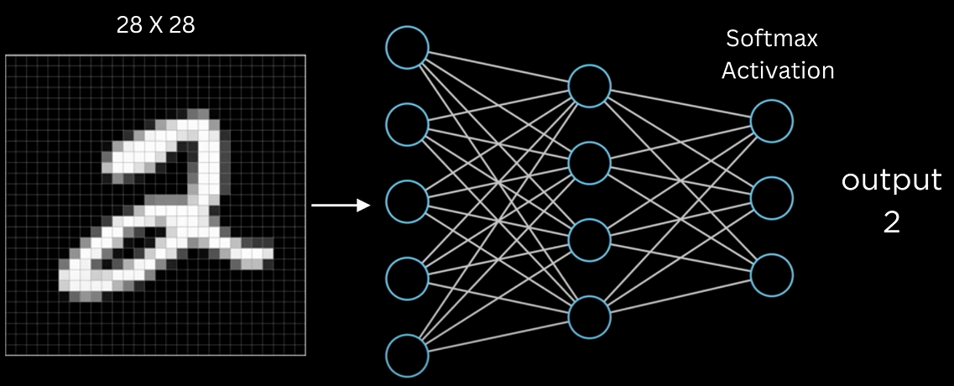
AI vs. Machine Learning
Artificial Intelligence: Systems that can mimic or simulate human-like intelligence (perception, reasoning, decision-making).
Machine Learning: A subset of AI that focuses on algorithms and statistical models to learn patterns from data.
Notes:
Terms widely merged today, but a solid definition….

Slide 14
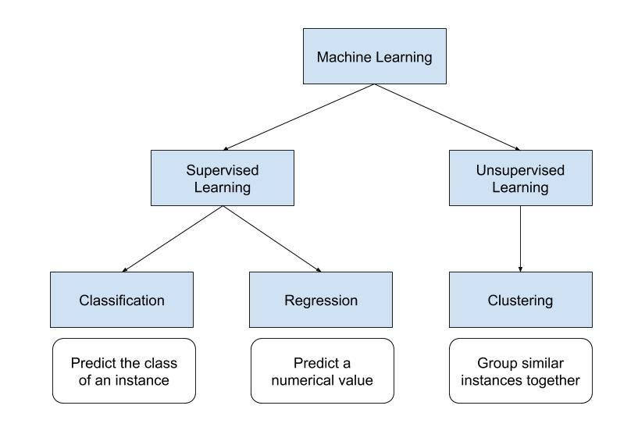
Very broad types of machine learning

Slide 15
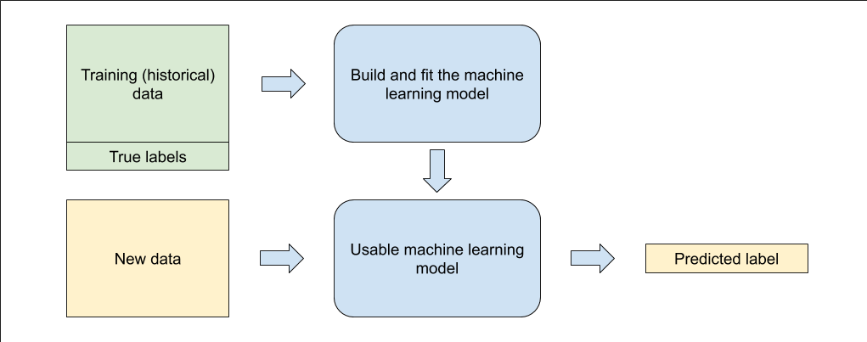

Slide 16
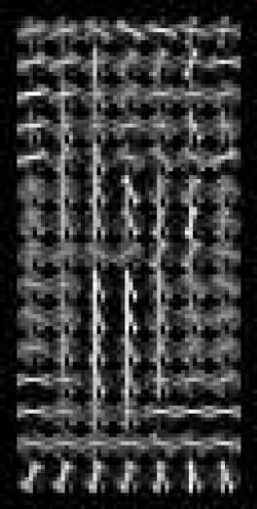
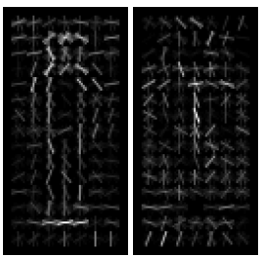
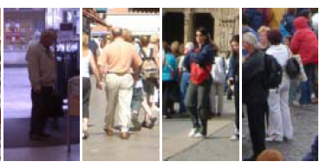
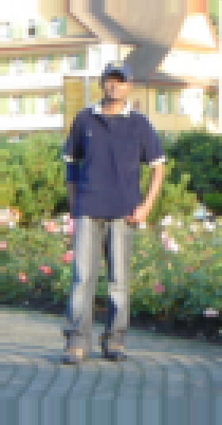
Classical Vs. Modern Machine Learning
“algorithms and statistical models to learn patterns from data.”
Classic approach is to “think really hard” about what features to extract, then use tools like logistic regression, support-vector machines or K-nearest neighbors.
Need ~10,000 example images with labels…
Thousands of parameters
Notes:
Need ~10,000 example images with labels…
Thousands of parameters

Slide 17
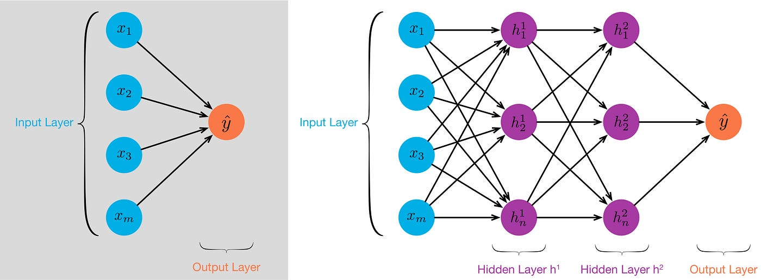
Neural Networks
Neural networks learn their own features; usually linear combinations of input features, and linear (*) combinations of those features.
Notes:
First, can’t JUST make new layers as linear combinations of previous layers, so there is an activation function

Slide 18
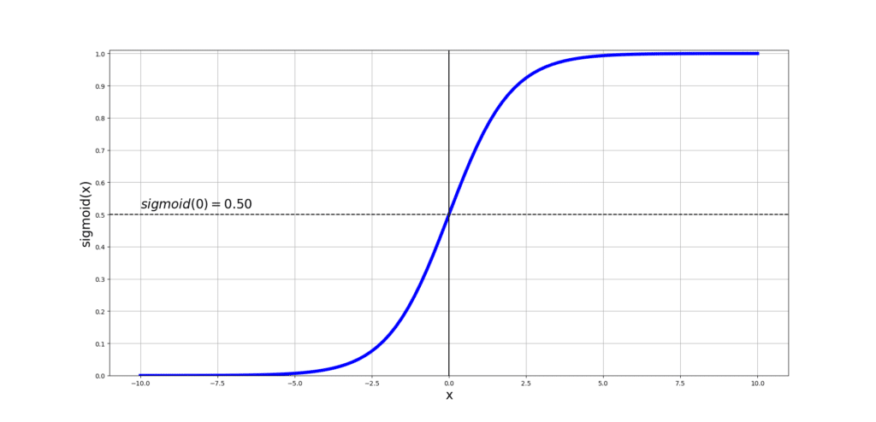
Neural Networks
Neural networks learn their own features; usually linear combinations of input features, and linear (*) combinations of those features.
Neural Networks were hot topics in research in Computer Science in 1980’s, but stopped for both a theoretical and practical reason
Notes:
A bit of history.

Slide 19
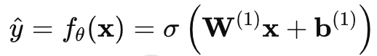
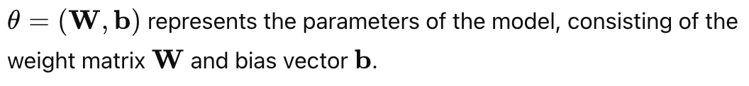
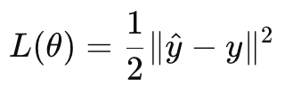
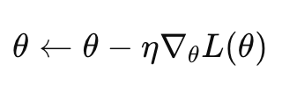
Given example (x,y), a loss function measures the error of the predicted output ŷ compared to y.
Training is done by computing the gradient of the Loss w.r.t. weights and biases, and updating the parameters, and iterating (many) times
Backpropagation is the name of an efficient algorithm for all the bookkeeping needed to do this when you have this functional form.
Notes:
A bit of history.

Slide 20
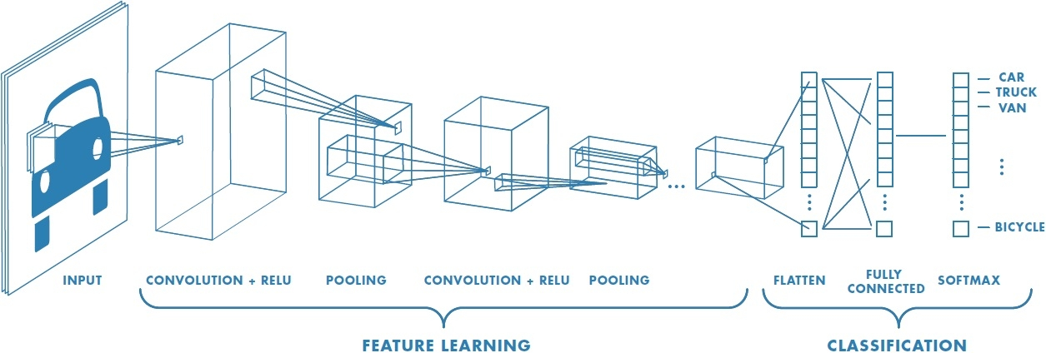
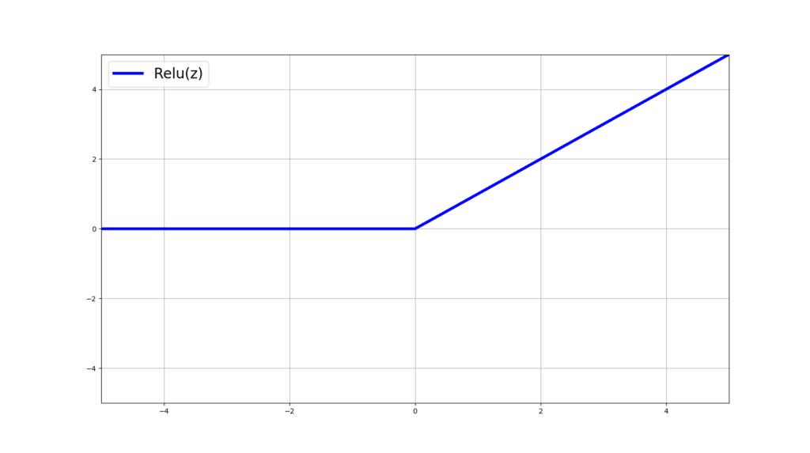
All modern Deep Learning/ Generative AI models are just *very* large neural networks
Sometimes structured to take advantage of redundancy or regularities in the data…
Modern networks have hundreds or thousands of layers.
Modern networks have billions or trillions (!) of weights.
Notes:
Imagenet was the first ve

Slide 21
~All modern Deep Learning/ Generative AI models are just *very* large neural networks
Trained based on very large training datasets. Loss function is the sum of errors over all training examples.
Backpropagation “needs to keep all examples in memory” to be efficient, so training is broken up into batches that fit into memory at once (and expensive GPUs are useful!). “Stochastic gradient descent”
Notes:
Imagenet was the first ve

Slide 22
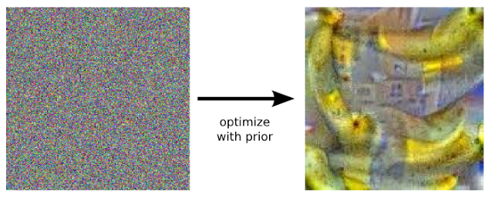
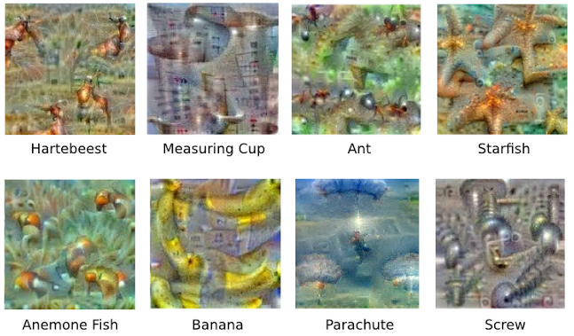
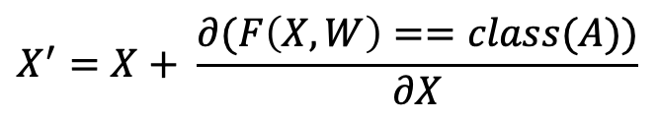
Network Visualization
Instead of training the network to give the right answer, tthe “image” to maximize how much it looks like some class A
$$X^{′}=X+ \frac{∂(F\left(X,W\right)==class(A))}{∂X}$$
Notes:
For the second method, see the Google Deep Dream team paper

Slide 23
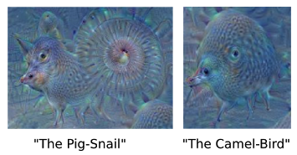
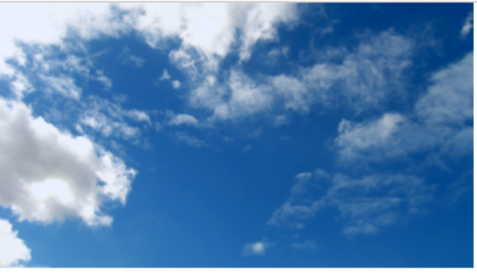
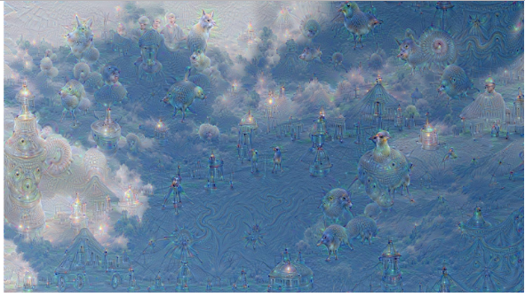
Network Visualization
Google Deep Dream
In rectangles in the input image, pick the 2 most active classes, and optimize the image to emphasize those
Notes:
Basic idea is ask network itself to enhance what it sees.

Slide 24
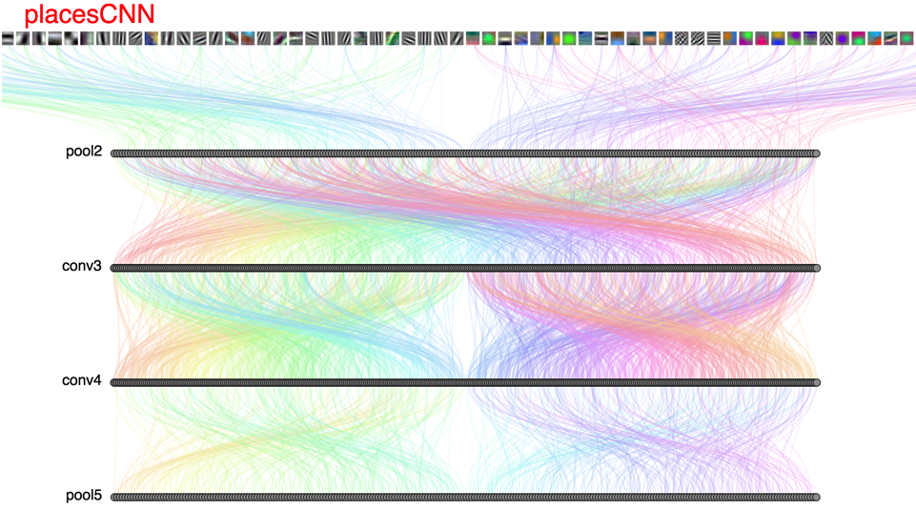
DrawNet: http://people.csail.mit.edu/torralba/research/drawCNN/drawNet.html
Looking inside the network:
Notes:
This tool created by Antonio Torralba’s group at MIT tries to help clarify what sorts of filters these deep networks are learning at different levels of the network.
It’s looking at the features learned by a convolutional neural network trained on the places dataset, which includes classes like “park”, “church” and also, “hotel”
At the very beginning, we can see that the network has learned low level features like edge and corner detectors –
these are the sorts of features that prior to the deep learning revolution were hand engineered, and it’s interesting to see that those sorts of features pop out of these learned representations as well.

Slide 25
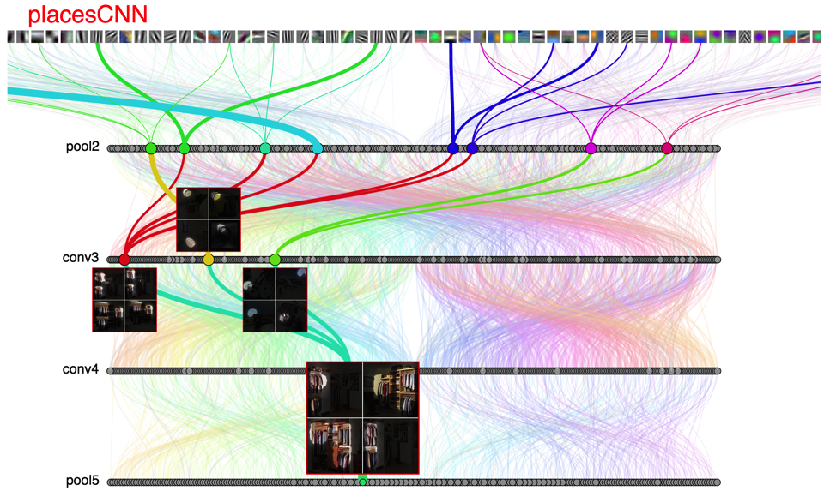
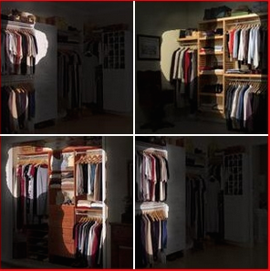
Notes:
Later in the network, we can see that there are filters that specifically encode much higher level features, like “closet”
So here, the visualization is showing that there’s series of filters that are highly activated by images that contain clothes hanging in a closet.

Slide 26
Parameters of a model
All the weights and biases (billions!)
Hyper-parameters (training) – learning rate, number of epochs, etc..
Hyper-parameters (testing) – any data pre-processing
Notes:
Imagenet was the first ve

Slide 27
Testing a model
Goal of the model is to be effective on *unseen* data.
Machine learning datasets are broken up into training data, validation data and testing data.
In best research paradigm, testing data is only ever seen once – validation data is used to select hyperparameters
“Validity” of the machine learning model is how well it works on testing data.
Notes:
Mostly don’t care about causal explanations, and don’t really care how the model works, except insofar as we think it will affect generalization to new datasets

Slide 28

Imagenet
14 million images
1000 classes
Now ~90% accuracy (top-5)

Slide 29
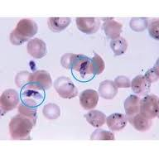
Fine-Tuning for Deep Learning
Start with Imagenet
Update those parameters with your own images and labels. Can often keep many of the weights the same, so much less training data is needed

Slide 30
Generative Models like GPT:
“I woke up this morning feeling….”
“The sky was a beautiful shade of….”
“My favorite food is….”

Slide 31
“I woke up this morning”

Slide 32
A small numerical representation of the input called a “token”
h₁
“I woke up this morning”

Slide 33
Classifier
A model that’s trained to predict: What’s a likely next word?
h₁
“I woke up this morning”

Slide 34
Classifier
A model that’s trained to predict: What’s a likely next word?
Trained on what? Every book, newspaper article, tweet, Wikipedia article, Reddit post, etc.
h₁
“I woke up this morning”

Slide 35
“feeling”
Classifier
h₁
“I woke up this morning”

Slide 36
“feeling”
“tired”
“so”
“I”
“went”
“to”
“sleep”
Classifier
Classifier
Classifier
Classifier
Classifier
Classifier
Classifier
h₁
h₂
h₃
h₄
h₅
h₆
h₇
h₁
h₂
h₃
h₄
h₅
h₆
h₇
“I woke up this morning”
“feeling”
“tired”
“so”
“I”
“went”
“to”

Slide 37
“feeling”
“so”
“excited”
“because”
“it”
“is”
“thanksgiving”
Classifier
Classifier
Classifier
Classifier
Classifier
Classifier
Classifier
h₁
h₂
h₃
h₄
h₅
h₆
h₇
h₁
h₂
h₃
h₄
h₅
h₆
h₇
“I woke up this morning”
“feeling”
“so”
“excited”
“because”
“it”
“is”

Slide 38
“feeling”
“so”
“unprepared”
“because”
“my”
“slides”
“weren’t”
Classifier
Classifier
Classifier
Classifier
Classifier
Classifier
Classifier
h₁
h₂
h₃
h₄
h₅
h₆
h₇
h₁
h₂
h₃
h₄
h₅
h₆
h₇
“I woke up this morning”
“feeling”
“so”
“unprepared”
“because”
“my”
“slides”

Slide 39
ChatGPT
But the general idea holds – take all of the text that humans have ever created, and learn the probability of words and phrases occurring with each other.
Given a new input, predict (based on the probabilities you’ve learned) what the most likely next phrase/response is.
Improved by Reinforcement Learning: Make the prediction and then let a human provide feedback on how good it is. Helps to learn ”better” answers.
Notes:
Reinforcement learning is learning from interaction with an environment to achieve some long-term goal that is related to the state of the environment. The goal is defined by reward signal (to be maximized).

Slide 40
20 Questions

Slide 41
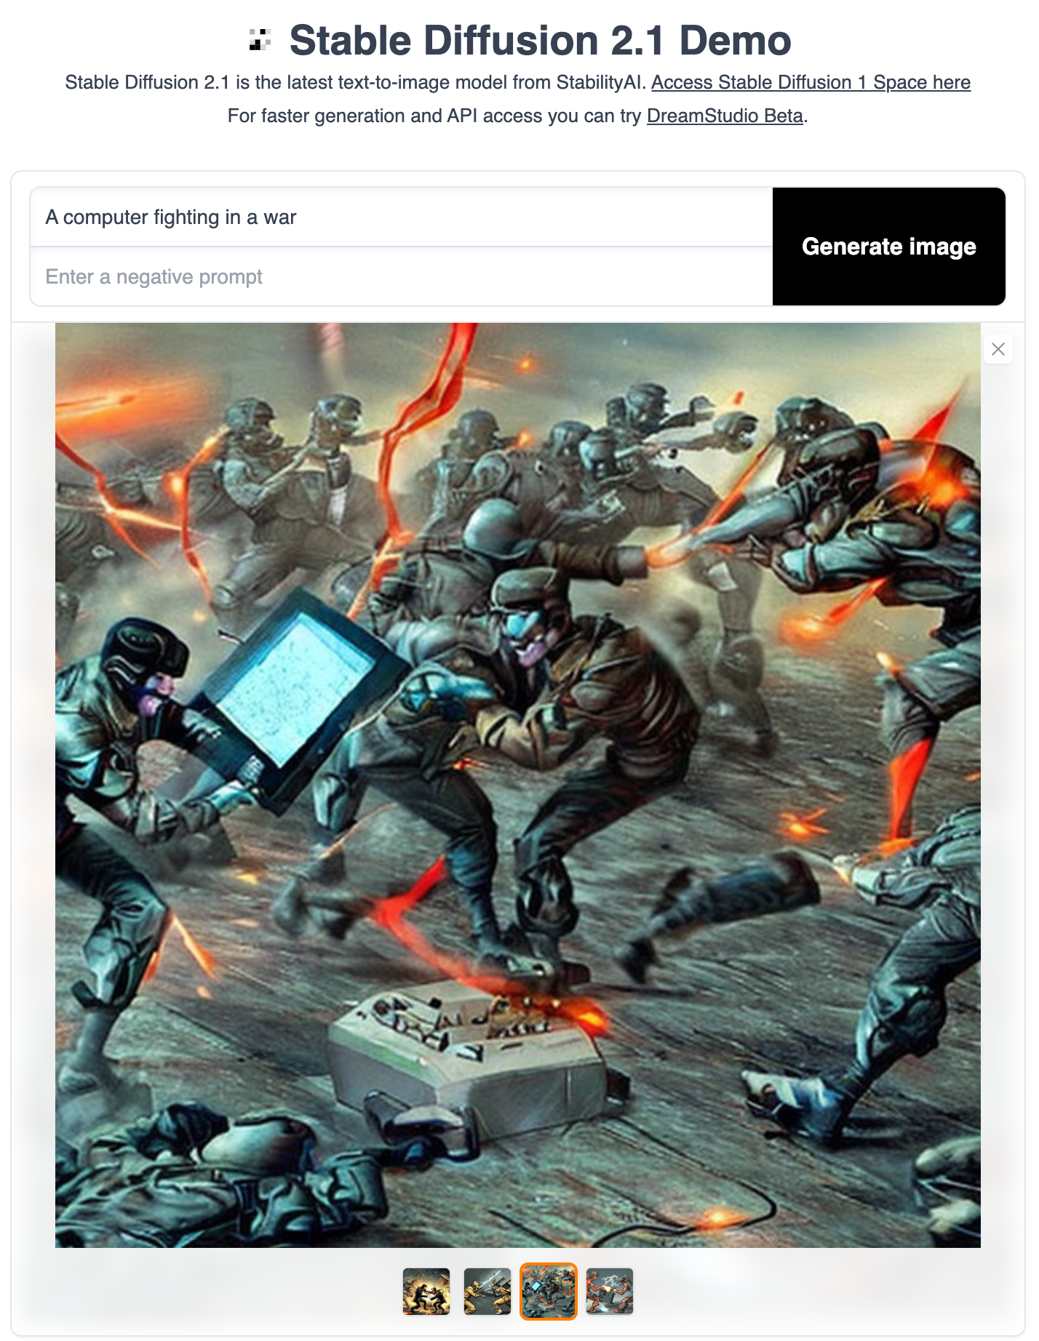
Not just text…
Scrape all of the images from the internet and their associated text/captions
Learn the relationship between text and images
Train a model to create new images that are aligned with particular captions

Slide 42
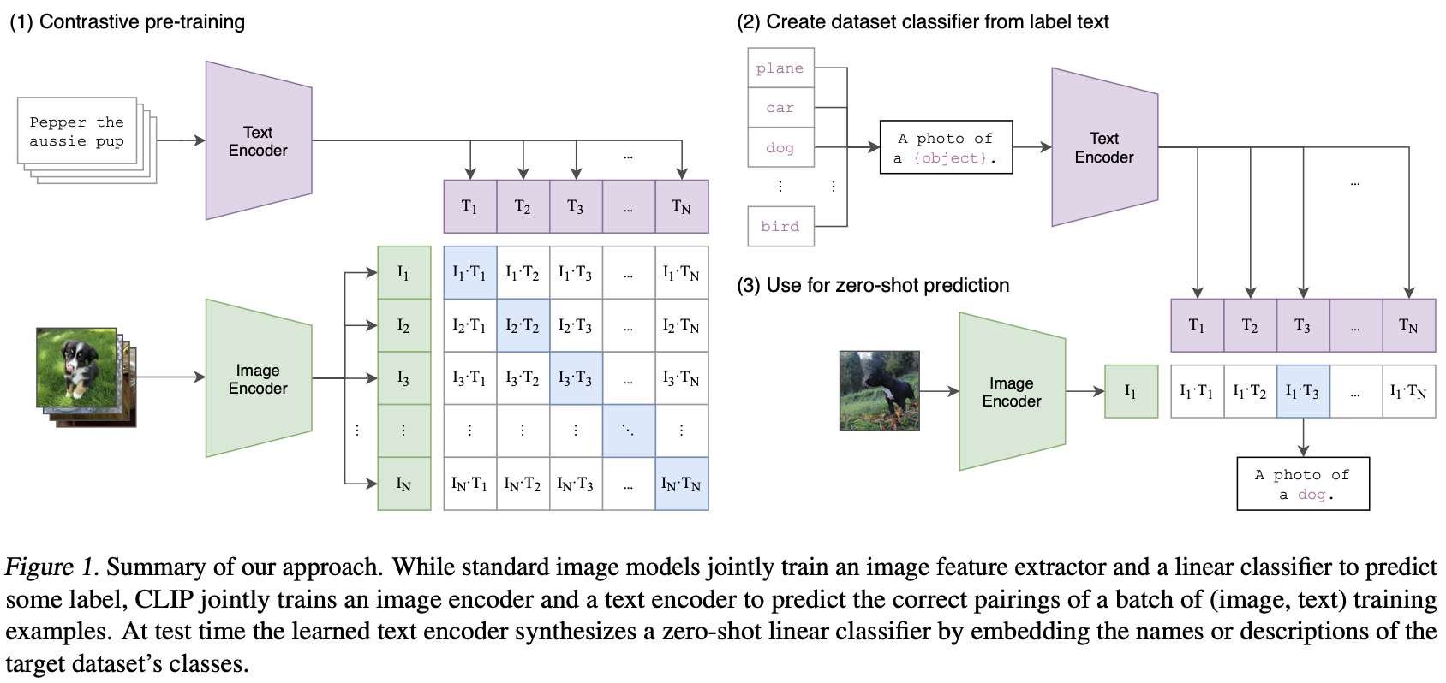
CLIP SPACE
CLIP (Contrastive Language Image Pre-Training), is the technical basis that allows current approaches to link images and text.
Trained on 5 billion pairs of (image, caption), CLIP has learned to embed images and related text to nearby locations (in a high-dimensional vector space).
This is surprisingly powerful.

Slide 43
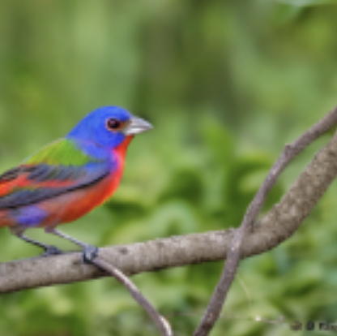
CLIP SPACE
Myrtle Warbler
“Orange Crowned Warbler”
Canada Warbler
Lazuli Bunting
Painted Bunting
“Painted Bunting”
This is surprisingly powerful. It also makes very quick, easy image classifiers

Slide 44
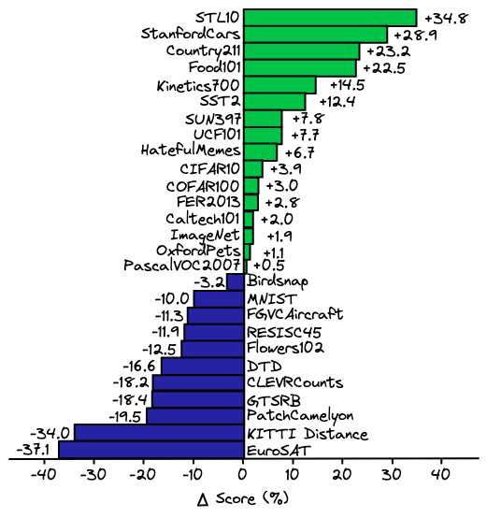
CLIP based classifiers outperform hand-tuned, specially trained classifiers for many, many datasets
If you have a problem for which you need image classification, you no longer need to talk to Computer Vision faculty. Now any good undergrad can make you a classifier for exactly the classes you care about.
…. But are they good?
This is surprisingly powerful. It also makes very quick, easy image classifiers

Slide 45
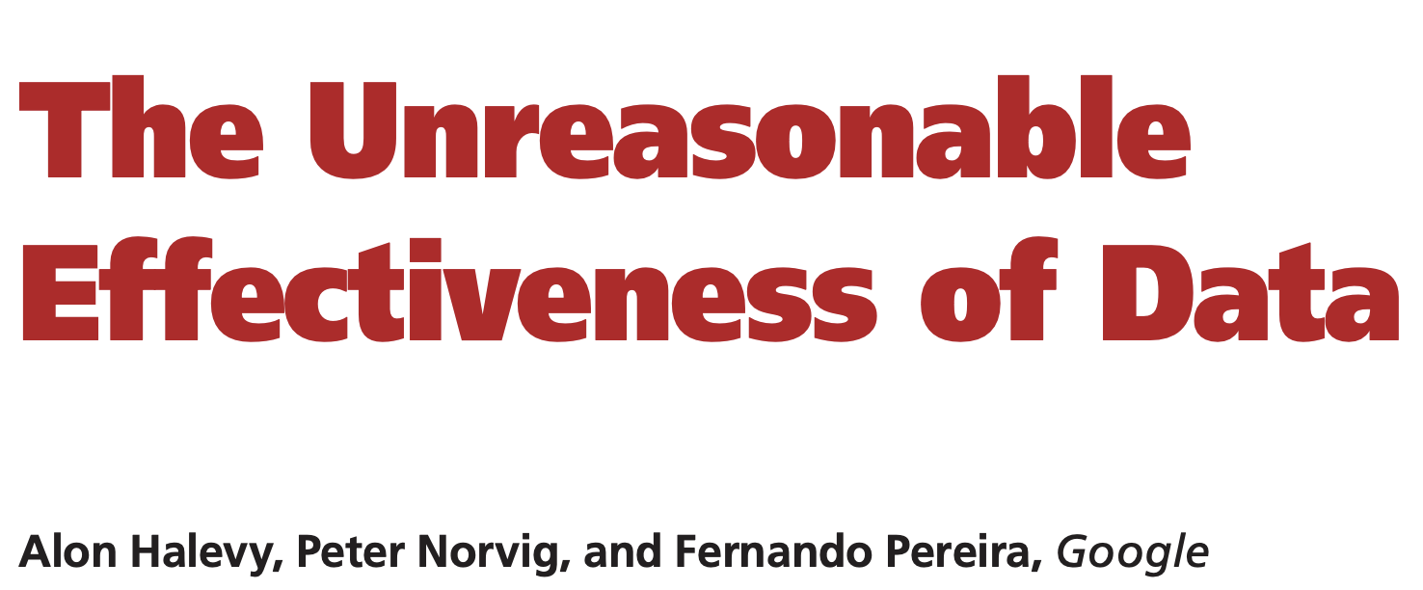
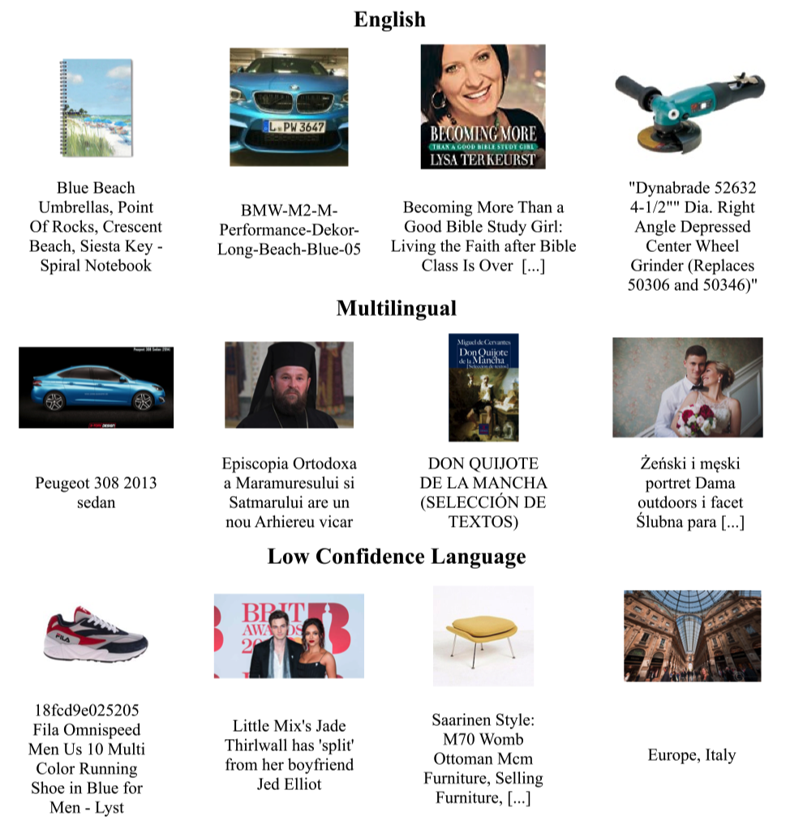
… even when your data is much less clean that you’d hope…
Example images + captions from the CLIP training data

Slide 46
Example images + captions from the CLIP training data

Slide 47
Example images + captions from the CLIP training data

Slide 48
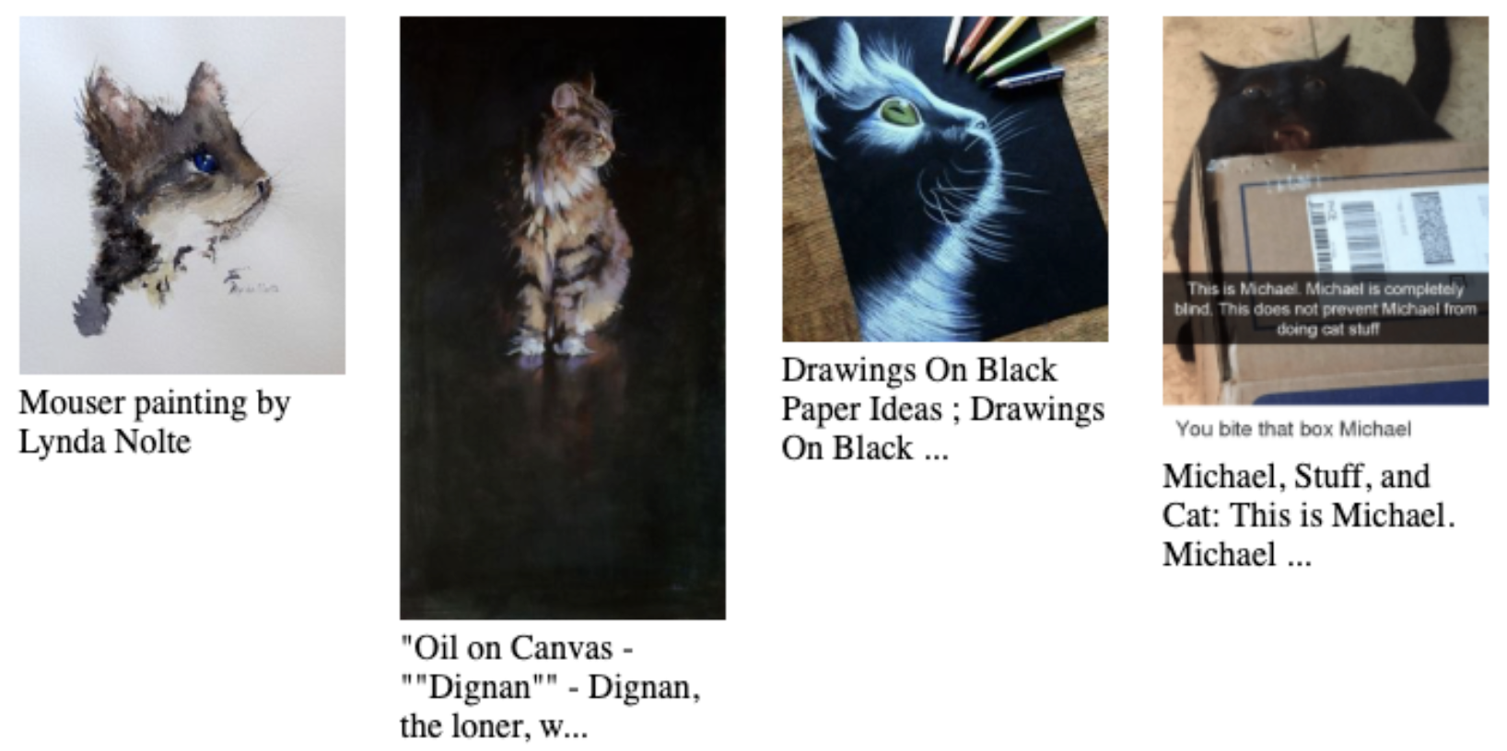
Example images + captions from the CLIP training data

Slide 49
CLIP SPACE
“Blue Cat”
Application 1: Query a large image dataset with arbitrary English

Slide 50
CLIP SPACE
“Blue Cat”
CLIP Features of all images in your database

Slide 51
CLIP SPACE
“Blue Cat”
CLIP Features of all images in your database
Retrieve nearby images as search results

Slide 52
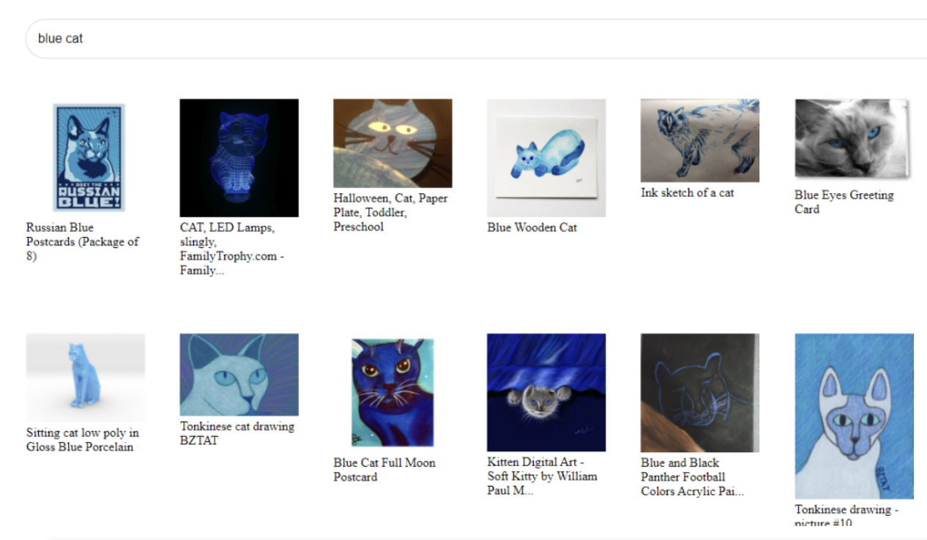
This allows generalizable image search for any feature you can name, even if that was not planned for when data was captured or stored.

Slide 53
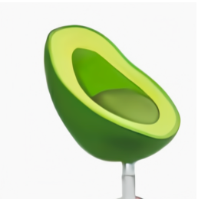
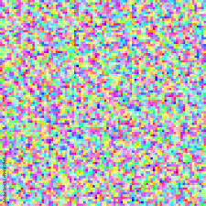
CLIP SPACE
“Avocado Chair”
Application 2: Dall-E. (“Generating images from Text”)
Your text is mapped into CLIP space to create an image target.
Then a random starting image is created and mapped into CLIP space.
Then gradient descent is used to update pixel values to change the image --- so that the CLIP embedding moves closer to the target

Slide 54
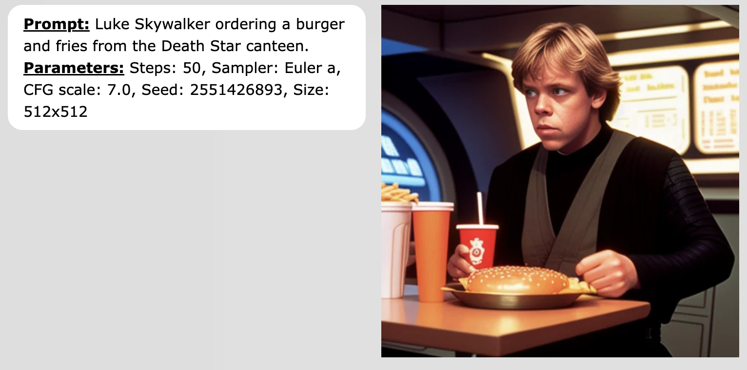
Shockingly Good (sometimes)

Slide 55
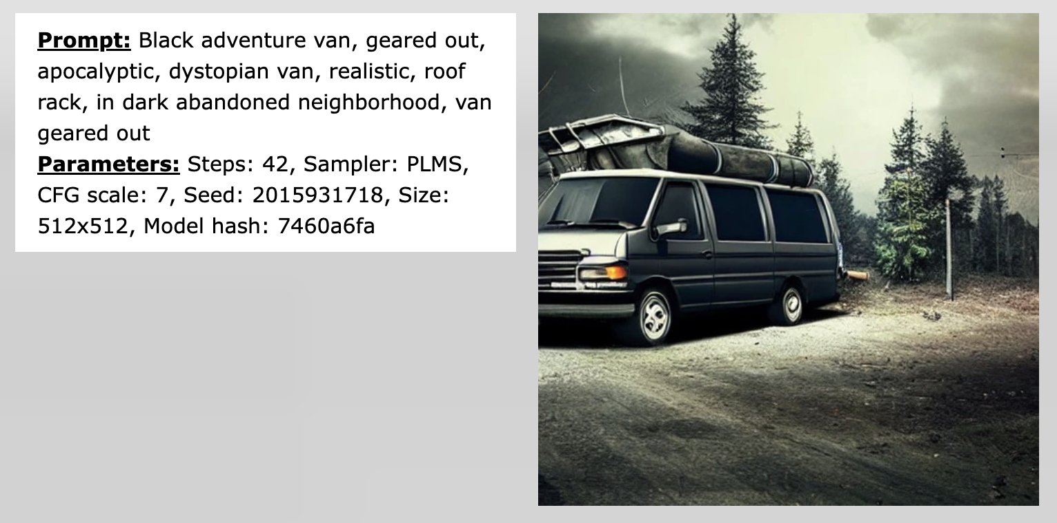
Shockingly Good (sometimes)

Slide 56
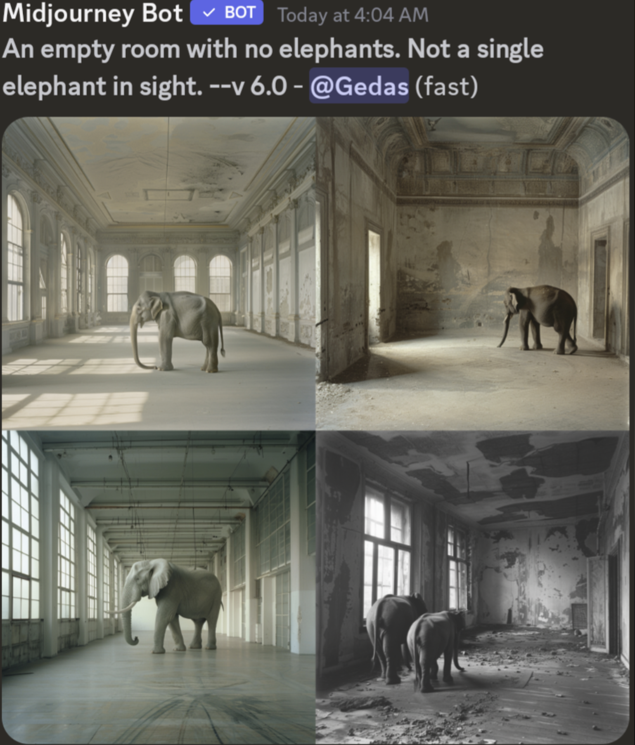
Shockingly Good (sometimes)
Why would this happen?
The CLIP model mapping text to images is trained with images and captions --- of all possible objects, what is most likely to be in an image with a caption that says “no elephant”?

Slide 57
”Multimodal AI”
Text
Image
Audio/sound
Codes
The approach of “tokenizing” inputs, and creating unified embeddings across modalities generalizes beyond text and images, also includes audio, 3D cameras, video data etc…

Slide 58
Last thoughts 1. Generative AI offers much much easier approaches for computation to directly touch the real world
2. Works extremely well if you stay within the distributions for which it was trained (next word! Images and captions…), but don’t ask it to write a long document…
3. Approaches to create guardrails, (e.g. so that Dall-E doesn’t create inappropriate images) are kludgy and incomplete
Notes:
Traditional AI/ML
Deep Learning
Generative

